Slide 1
We’re excited to have you with us today. We'll get started shortly.
In the meantime, take a moment to complete our quick poll. Thank you.

Slide 2


Build Accurate, Custom Agentic RAG Systems Locally with HP AI Studio

Slide 3
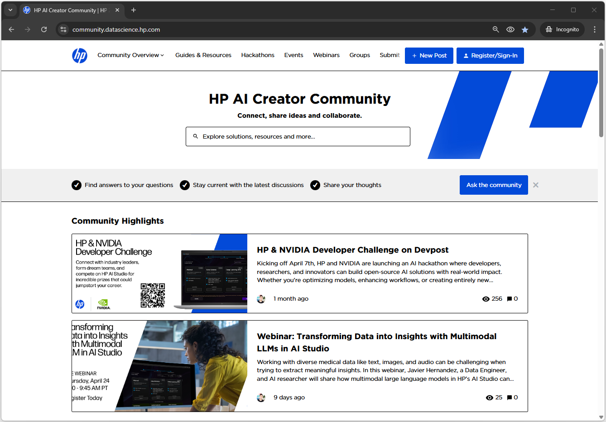

Join the HP AI Creator Community
Engage, share ideas, and find solutions.
Join the HP AI Creator Community for Early Access Programs (EAPs), upcoming webinars, and the latest updates on HP AI solutions and resources
Visit or scan below: community.datascience.hp.com

Slide 4







Housekeeping
The session will run for approximately 30-40 minutes, followed by a Q&A. To help ensure everything runs smoothly, please keep in mind the following:
No mics
No chat
Q&A
Be respectful
Reach out
Attendees will
be muted.
The chat function is not active.
The Q&A function is active, ask in Q&A.
Please be respectful of other participants.
Ask questions anytime through the community.

Slide 5

Speakers
Ata Turhan
HP AI Engineer

Slide 6

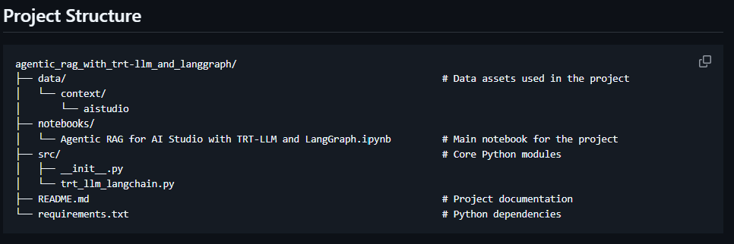
Architecture
agentic-rag-with-tensorrtllm

Slide 7
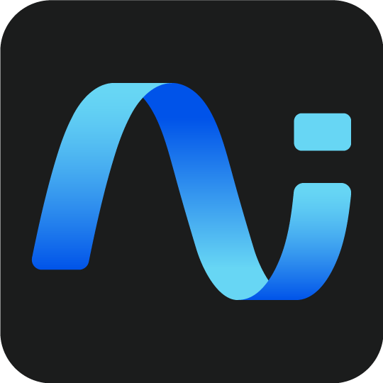


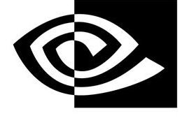
Using TensorRT_LLM for Inference with AI Studio
Hardware
HP Z8 G5 Fury
NVIDIA RTX 6000 ada GPU with 48 GB VRAM
Intel 44 Core Xeon CPU
64+ GB of RAM
System
Windows 11
HP AI Studio
NVIDIA NGC Catalog
NVIDIA NeMo 25.04
NVIDIA Llama-3.1-Nemotron-Nano-8B-v1
NVIDIA TensorRT_LLM
Create isolated project with full GPU access
Download NeMo, Nemotron, and TensorRT_LLM packages and models
Set memory store, retriever, vectorDB, LLM, agentic tasks, and graph
Ensure prompt structure maps to LLM
Test the agentic flow using TensorRT_llm for inference acceleration
Deploy model services locally
AI Studio
AI Studio
+
NVIDIA
Popular
Open Source
Tools
AI Studio
AI Studio
+
NVIDIA
AI Studio
Notes:
Ollama quick and easy

Slide 8
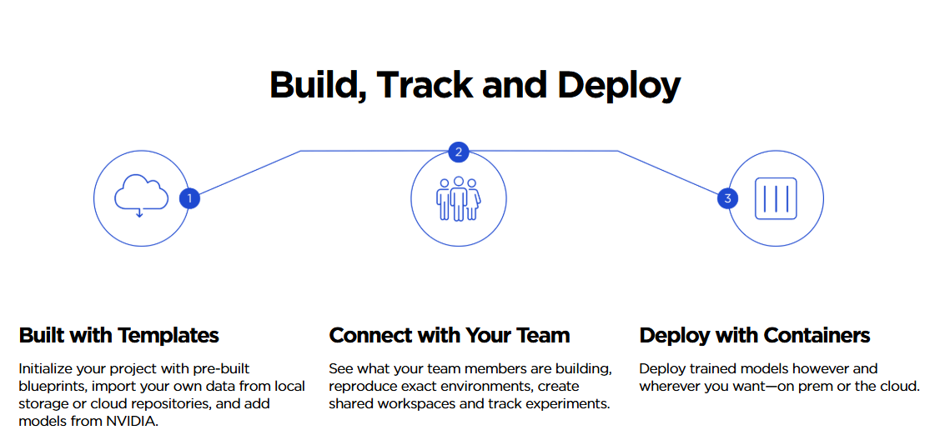
HP AI Studio
8

Slide 9
Image
NeMo Framework
The NeMo Framework is a pre-configured Docker container designed to streamline the development of conversational AI and large language model (LLM) applications.
Includes libraries such as PyTorch, TensorRT-LLM, and NVIDIA’s NeMo toolkit, along with CUDA, cuDNN, and other optimized backends for accelerated inference and training.

Slide 10

LLM
Llama-3.1-Nemotron-Nano-8B-v1
Llama-3.1-Nemotron-Nano-8B-v1 is a reasoning model derivative of Meta Llama-3.1-8B-Instruct (the reference model).
It is a post trained for reasoning, human chat preferences, and tasks, such as RAG and tool calling.

Slide 11
Inference Library
TensorRT-LLM
TensorRT-LLM is an open-source library developed to optimize and accelerate inference of large language models (LLMs) on NVIDIA GPUs.
It integrates tightly with TensorRT and CUDA to deliver low-latency, high-throughput performance, supporting features like FP8 precision, paged attention, and tensor parallelism.

Slide 12
Agentic Framework
LangGraph
LangGraph is a graph-based orchestration framework built on LangChain, designed for managing multi-step, stateful workflows in agentic RAG systems.
Used to coordinate retrieval, planning, and generation steps by modeling each action.

Slide 13
Vector Database
Chroma
Chroma is a vector database to store and retrieve document embeddings efficiently. Chroma enables fast similarity search by indexing high-dimensional vectors. It supports metadata filtering, and is optimized for local development with minimal setup, making it ideal for lightweight, real-time agentic workflows.

Slide 14
Demo

Slide 15
Q&A

Slide 16
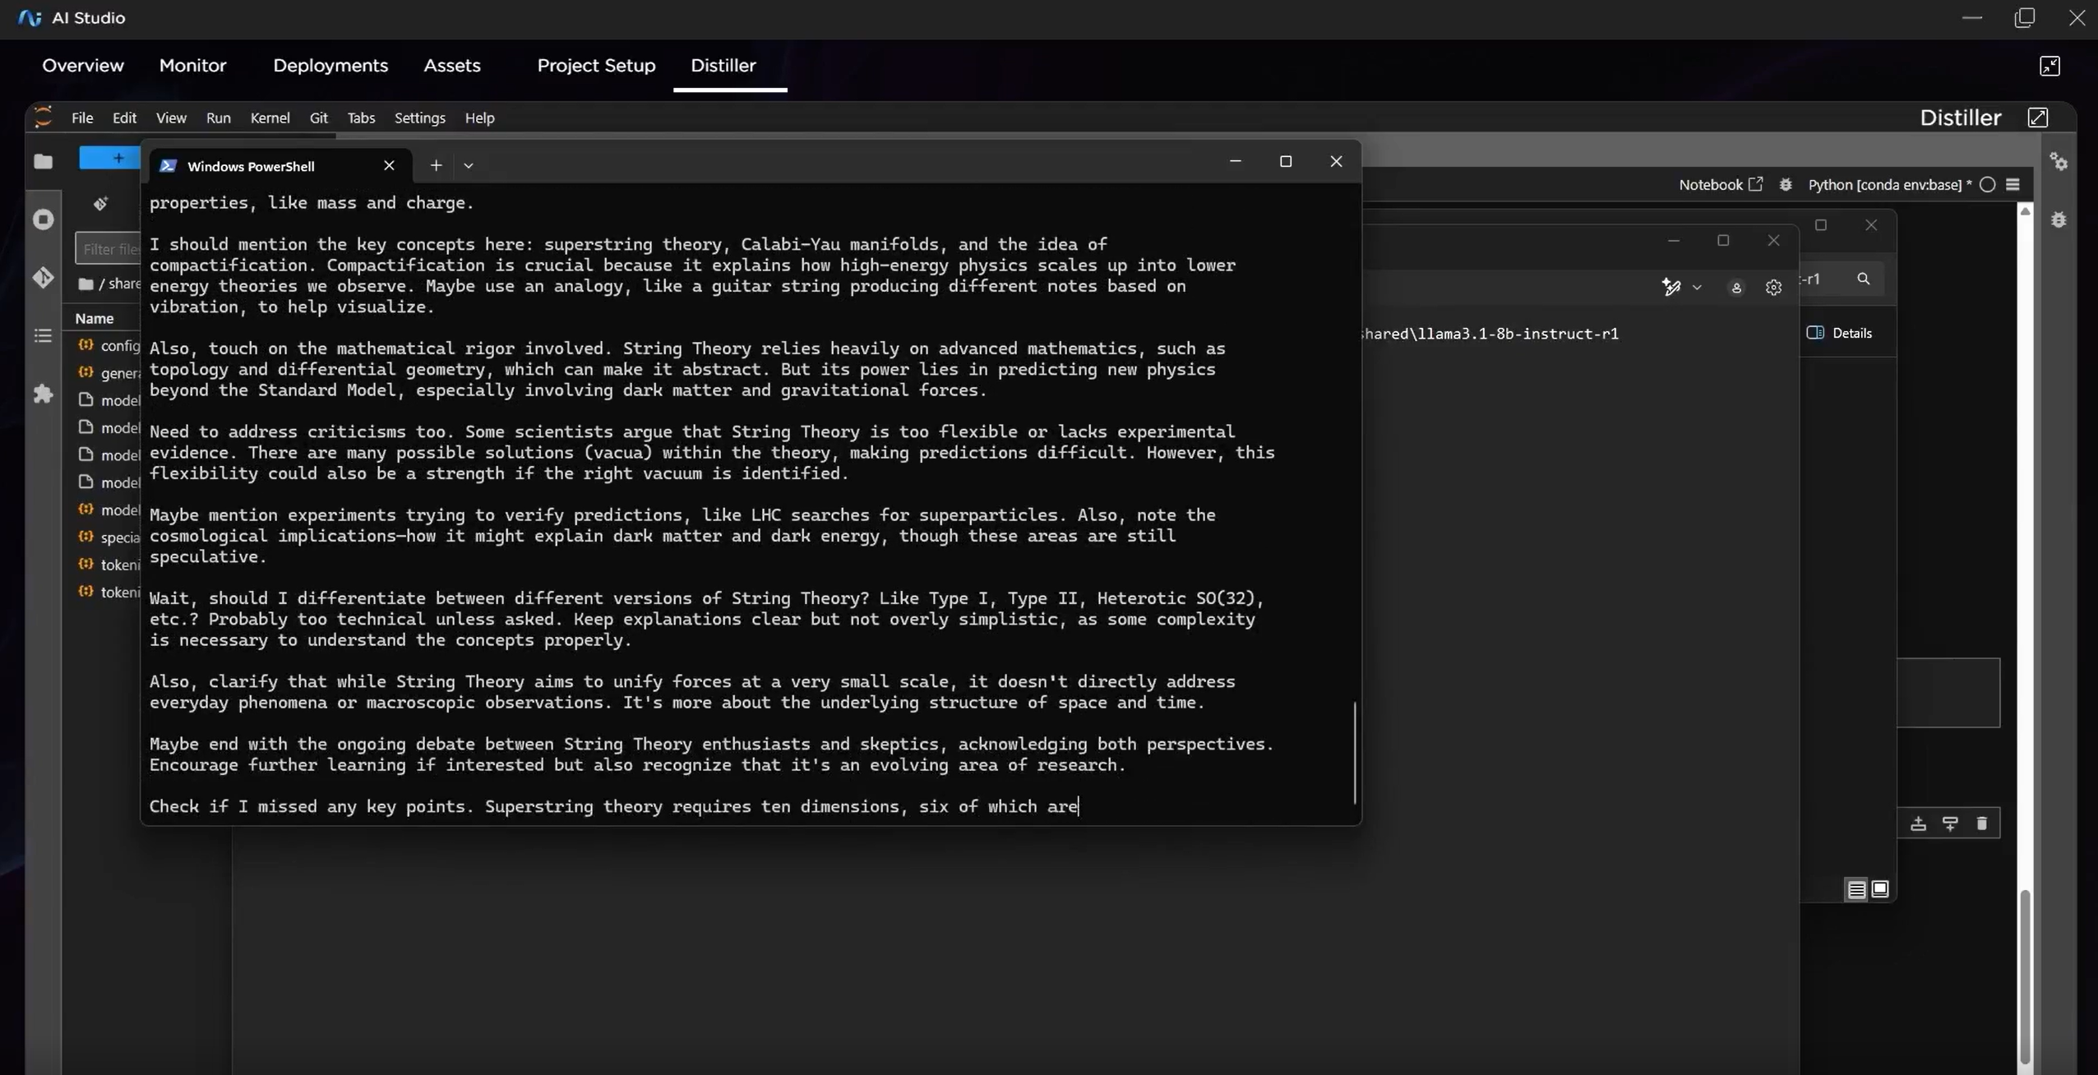


Thank you for Joining!
Try Yourself
Get Started
Webinar Library
HP AI Solutions

Slide 17
NVIDIA Resources
1- NVIDIA GPU (RTX 6000 ADA)
2- NVIDIA Image (NeMo Framework)
3- NVIDIA LLM (Llama-3.1-Nemotron-Nano-8B-v1)
4- NVIDIA Inference Library (TensorRT-LLM)
5- NVIDIA NGC Catalog of GPU optimized assets

